Slide 1
CSE 12 – Basic Data Structures and Object-Oriented Design Lecture 25
Greg Miranda & Paul Cao, Winter 2021
This lecture is being recorded

Slide 2
Announcements
Quiz 25 due Friday @ 8am
Last quiz!!
Survey 10 due Friday @ 11:59pm
PA8 due Thursday @ 11:59pm
No pre-recorded lecture for Friday
Final Review
Final Exam
Starts Saturday, March 13th @ 8:00am
Ends Monday, March 15th @ 11:59pm
3 hour exam – clock starts when you open exam
Must be finished in one sitting
Reminder: Complete CAPE
1 pt challenge

Slide 3
Topics
Improved Lists
Questions on Lecture 25?

Slide 4
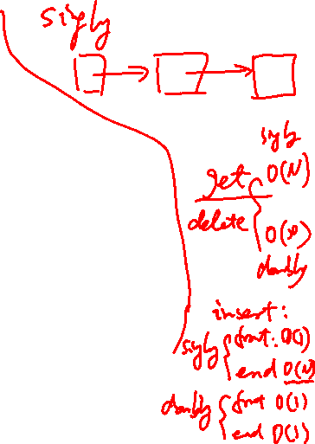
Doubly linked lists
MyLinkedList
object
Dummy head and tail nodes
head
Node
object
Node
object
Node
object
tail
size
next
next
next
null
1
data
null
data
data
null
Linked list object stores pointer to the tail
prev
null
prev
prev
Objects of type E:

Slide 5

Types of Linked Lists
Singly linked list
Doubly linked list
Circular singly linked list
Circular doubly linked list

Slide 6
Iterator objects: Picture
tail
head
NULL
NULL
left
right
idx
0
canRemove
false
forward
true
MyListIterator

Slide 7
Accessing and setting node fields
NULL
NULL
this
Imagine that you are working in the MyListIterator class. Write a line of code that modifies “right” to point to the next node in the list.
left
right
idx
0
canRemove
false
forward
true
MyListIterator

Slide 8

Accessing and setting node fields
NULL
NULL
this
Imagine that you are working in the MyListIterator class. How would you access the field highlighted in red from the iterator object (this)? (for this question, assume Node's next and prev are public)
You can’t
current.prev
this.right.next
this.right.prev
this.right.next.prev
left
right
idx
0
canRemove
false
forward
true
MyListIterator
Notes:
E

Slide 9
T next()
Return the next element in the list when going forward.
Throw NoSuchElementException if there is no such element
tail
head
NULL
NULL
it
What would be returned by a call to it.next()?
The Node referenced by right
The Node referenced by left
The item stored in right.data
The item stored in left.data
The method would throw a NoSuchElementException
left
right
idx
0
canRemove
false
forward
true
MyListIterator
Notes:
C

Slide 10
T next()
Return the next element in the list when going forward.
Throw NoSuchElementException if there is no such element
tail
head
NULL
NULL
it
What instance variables would change value in it during a call to it.next()?
left, right
left, right, idx
right, idx
left, right, idx, canRemove
Other
left
right
idx
0
canRemove
false
forward
true
MyListIterator
Notes:
D

Slide 11
T next()
Return the next element in the list when going forward.
Throw NoSuchElementException if there is no such element
tail
head
NULL
1
2
NULL
it
What instance variables would change value in it during a call to it.next()?
left, right
left, right, idx
right, idx
left, right, idx, canRemove
Other
left
right
idx
1
canRemove
true
forward
true
MyListIterator

Slide 12
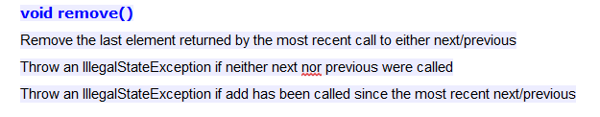

tail
head
NULL
1
2
NULL
it
Which node would be removed with a call to it.remove()?
The node with the element 1
The node with the element 2
A different node
This would throw an IllegalStateException
left
right
idx
1
canRemove
true
forward
true
MyListIterator
Notes:
A

Slide 13
tail
head
NULL
1
2
NULL
it
Now which node would be removed with a call to it.remove()?
The node with the element 1
The node with the element 2
A different node
This would throw an IllegalStateException
left
right
idx
1
canRemove
true
forward
false
MyListIterator

Slide 14
CAList expandCapacity()
Finish expandCapacity() for the Circular Array List (CAList).
How would you test it to confirm that it works?

Slide 15
Questions on Lecture 25?

